Slide 1
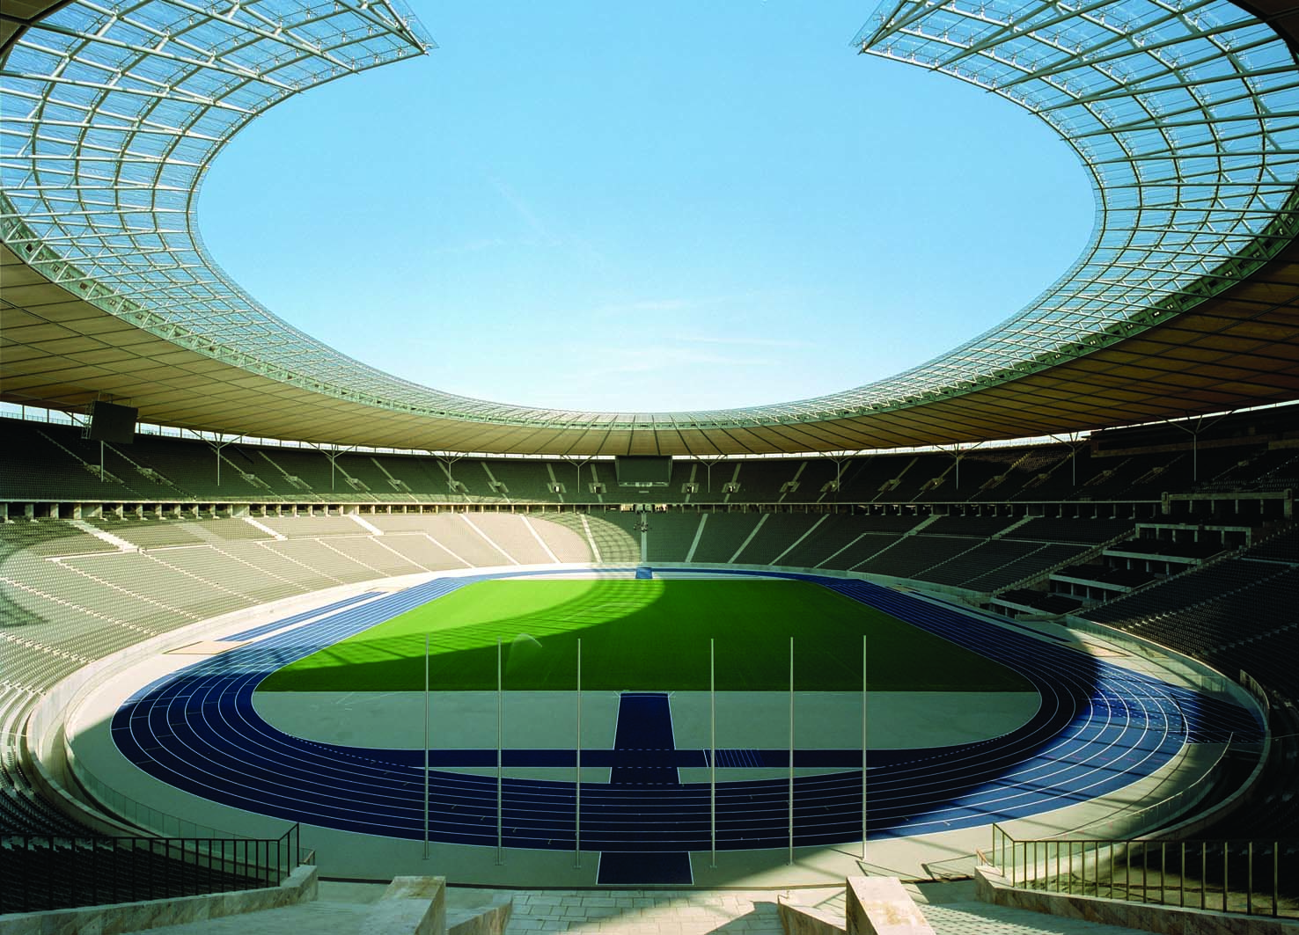
8
THE DATA OF MACROECONOMICS

Slide 2
23
Measuring a Nation’s Income

Slide 3

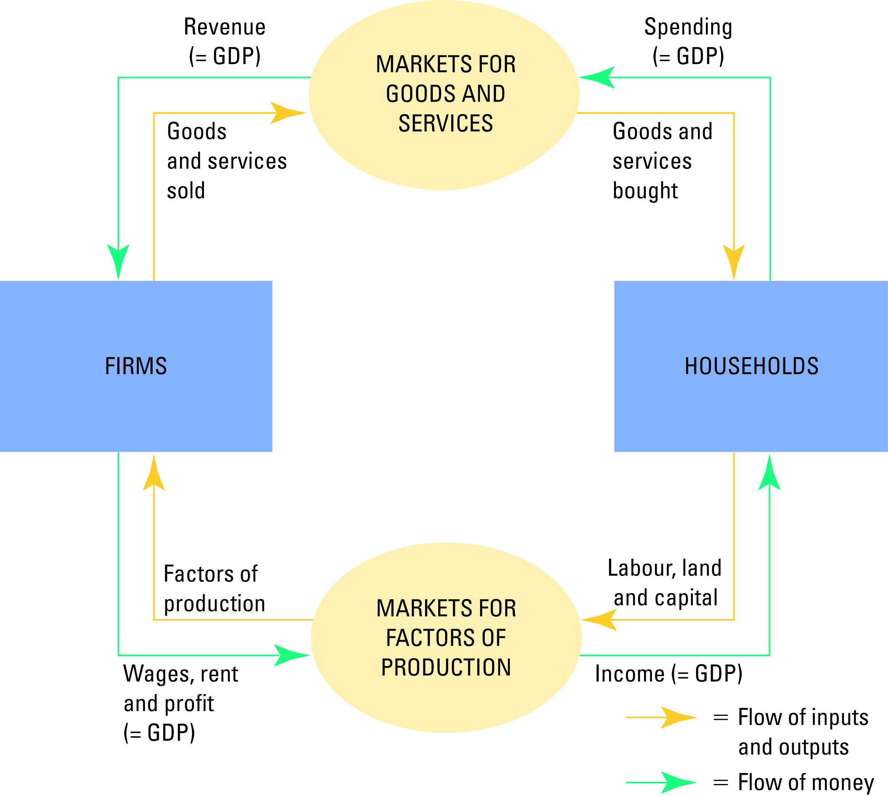
Figure 1 The Circular-Flow Diagram
Copyright © 2004 South-Western

Slide 4

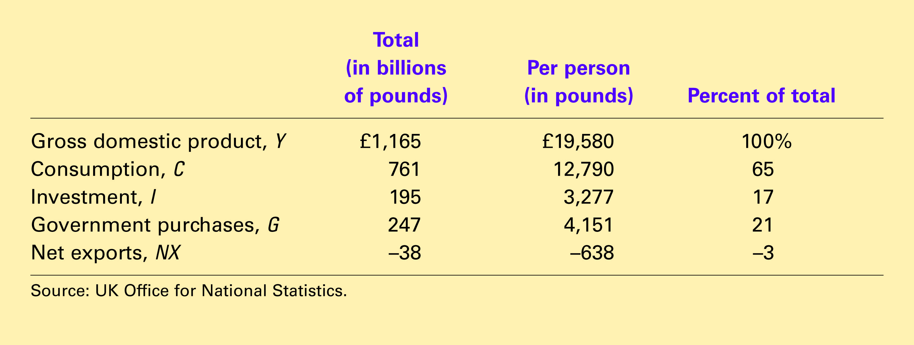
Table 1 GDP and Its Components
Copyright©2004 South-Western

Slide 5
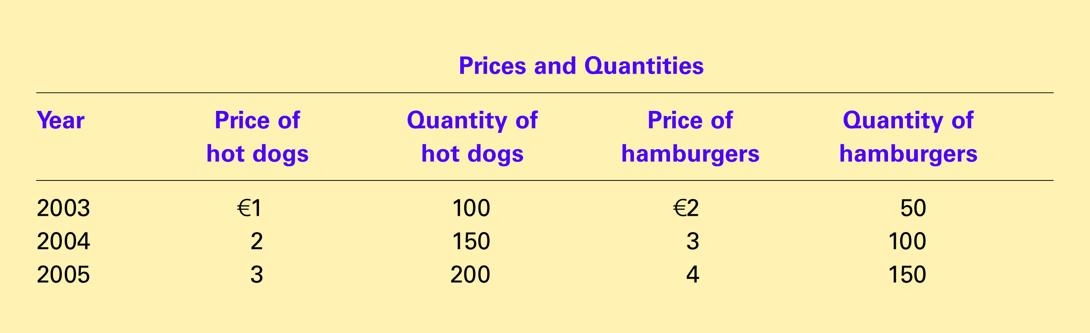
Table 2 Real and Nominal GDP
Copyright©2004 South-Western

Slide 6
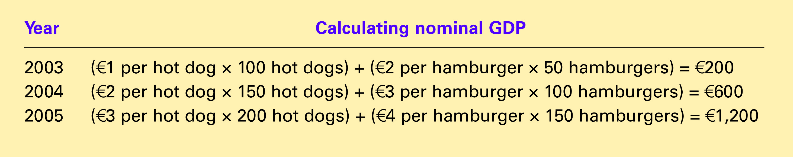
Table 2 Real and Nominal GDP
Copyright©2004 South-Western

Slide 7
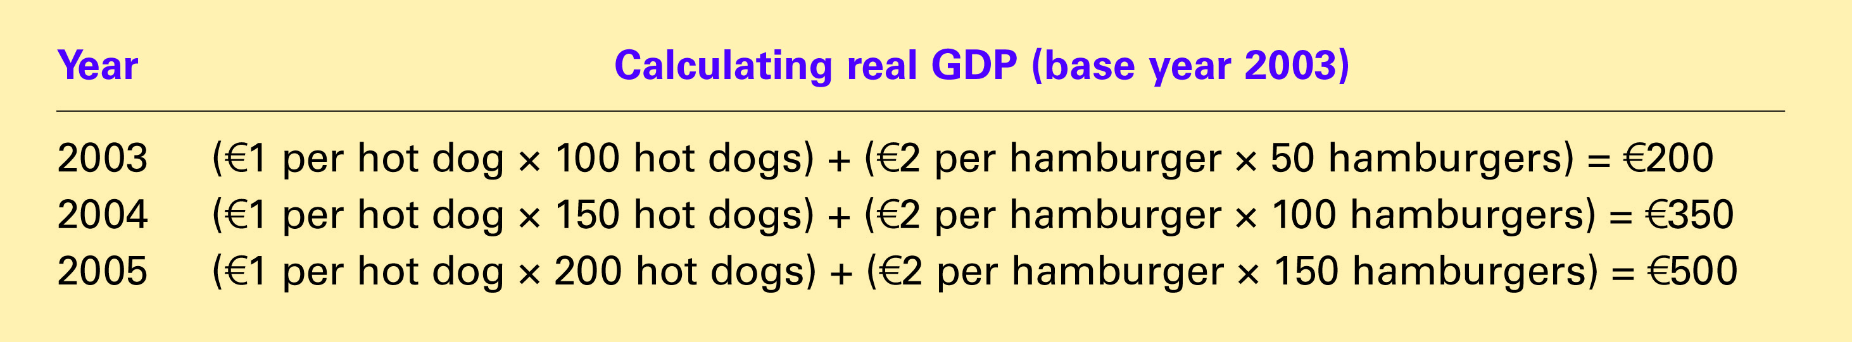
Table 2 Real and Nominal GDP
Copyright©2004 South-Western

Slide 8

Table 2 Real and Nominal GDP
Copyright©2004 South-Western

Slide 9
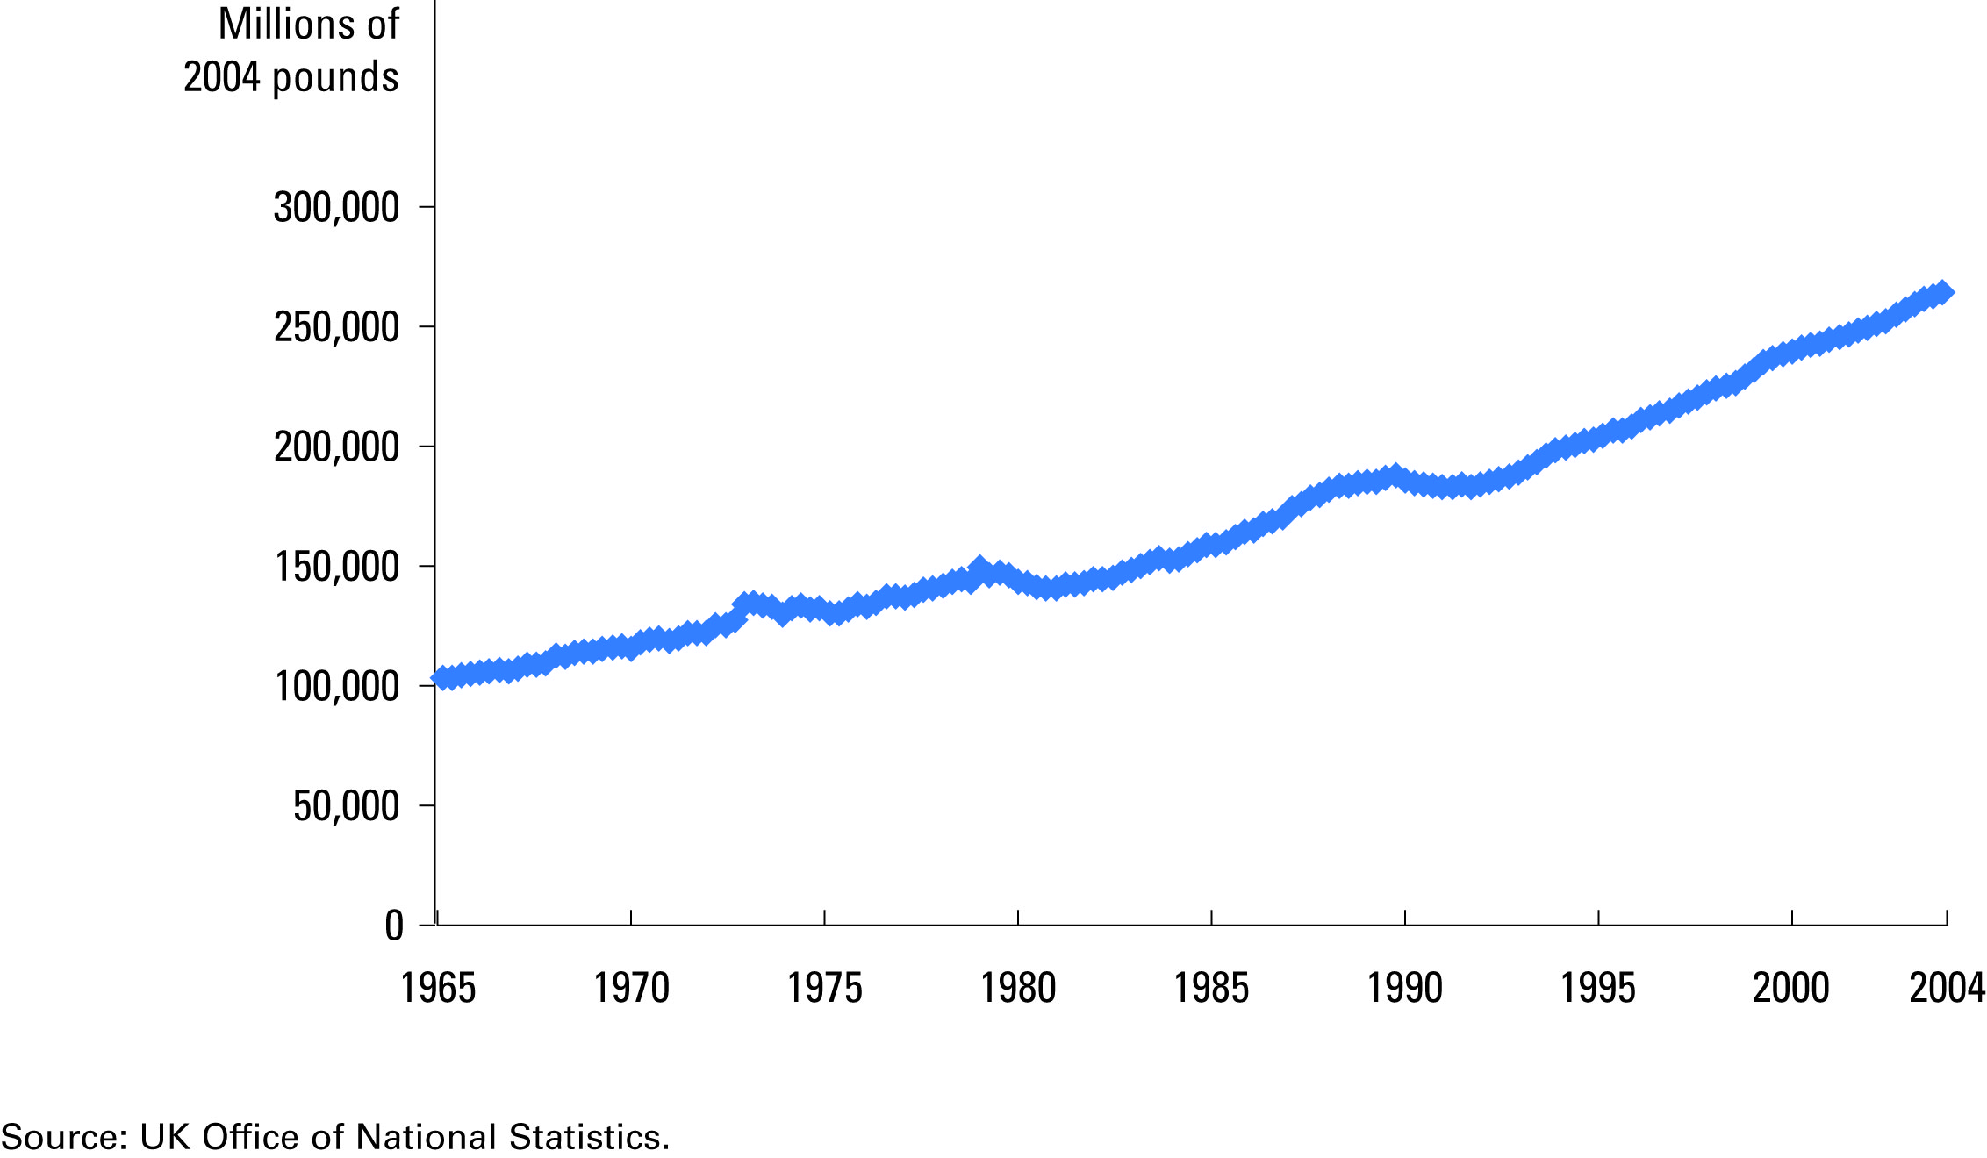
Figure 2 Real GDP in the United Kingdom
Copyright © 2004 South-Western

Slide 10
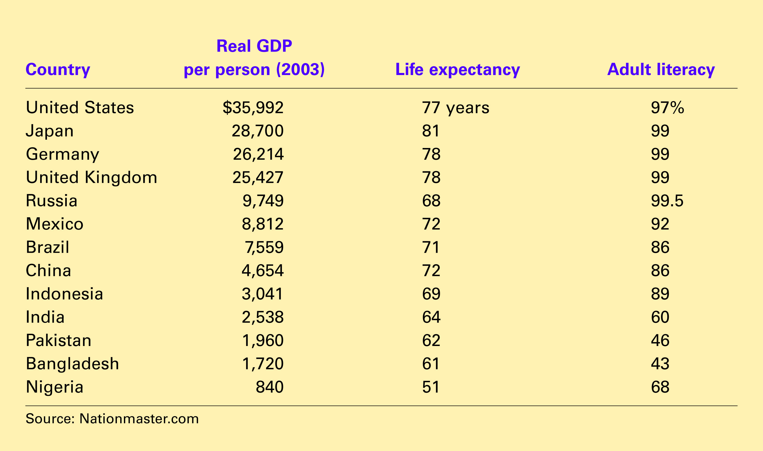
Table 3 GDP, Life Expectancy, and Literacy
Copyright©2004 South-Western

